Slide 1
Lambda
Week 11 – Lambda Step-by-Step

Slide 2
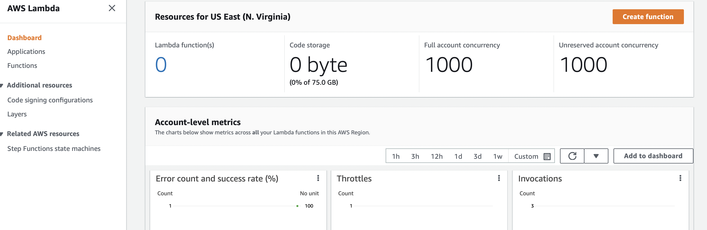

Slide 3
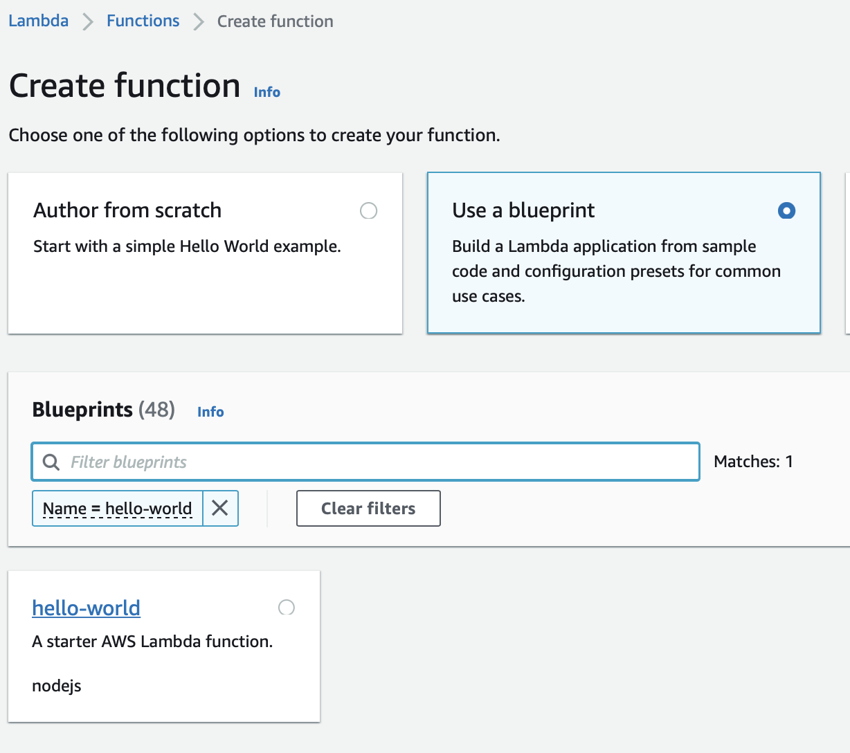

Slide 4
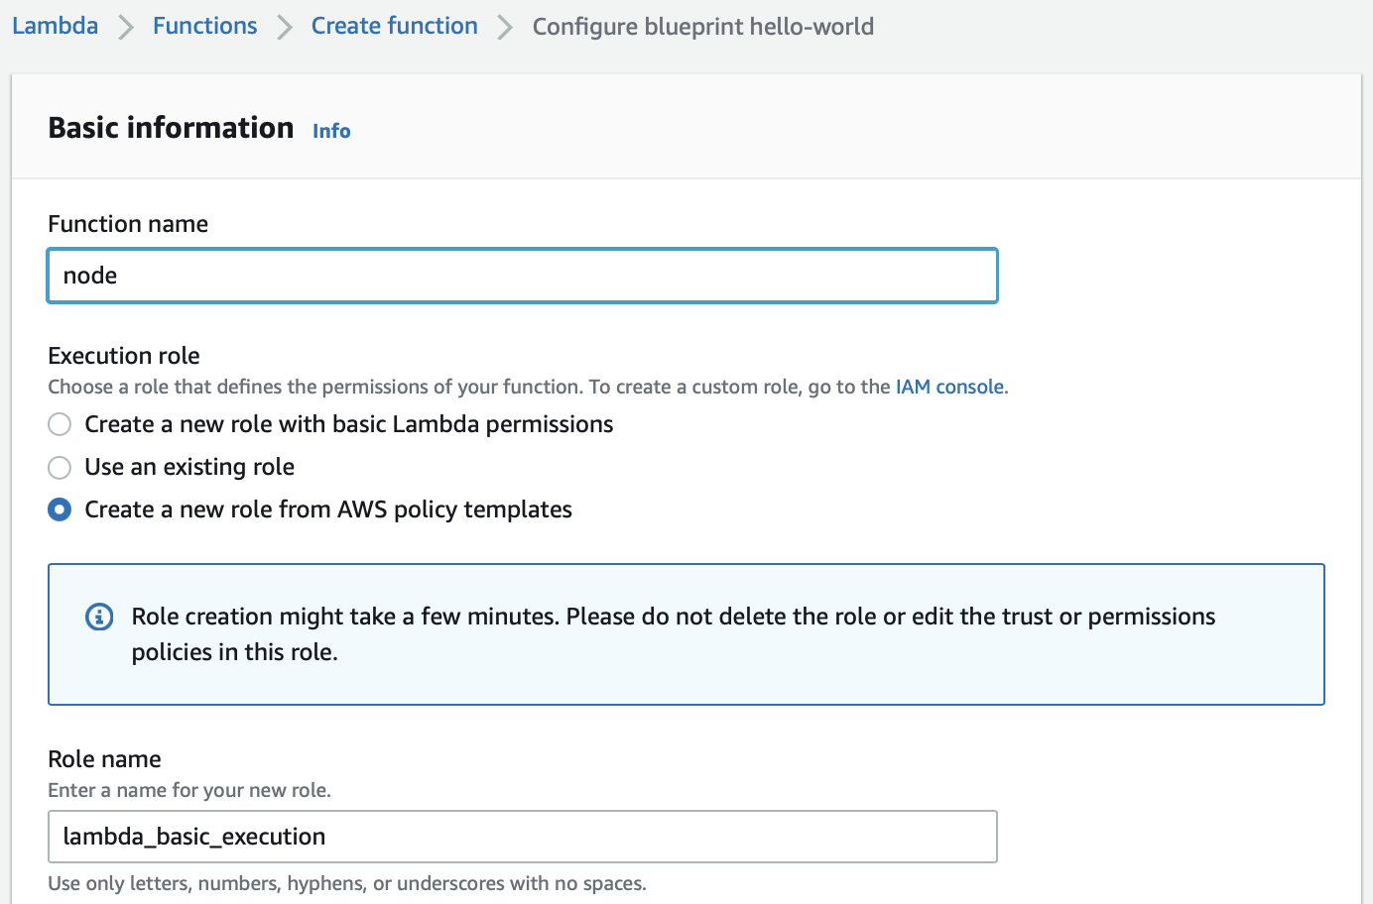
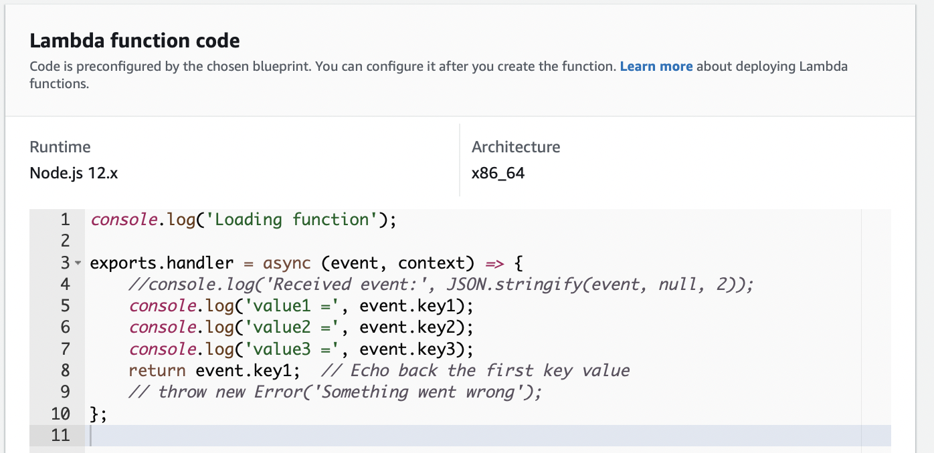
Each Lambda function will have a single job to do

Slide 5
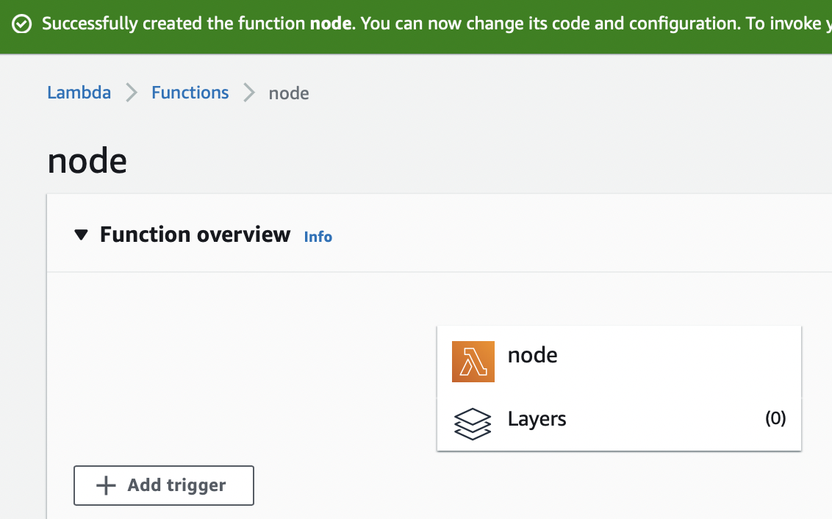
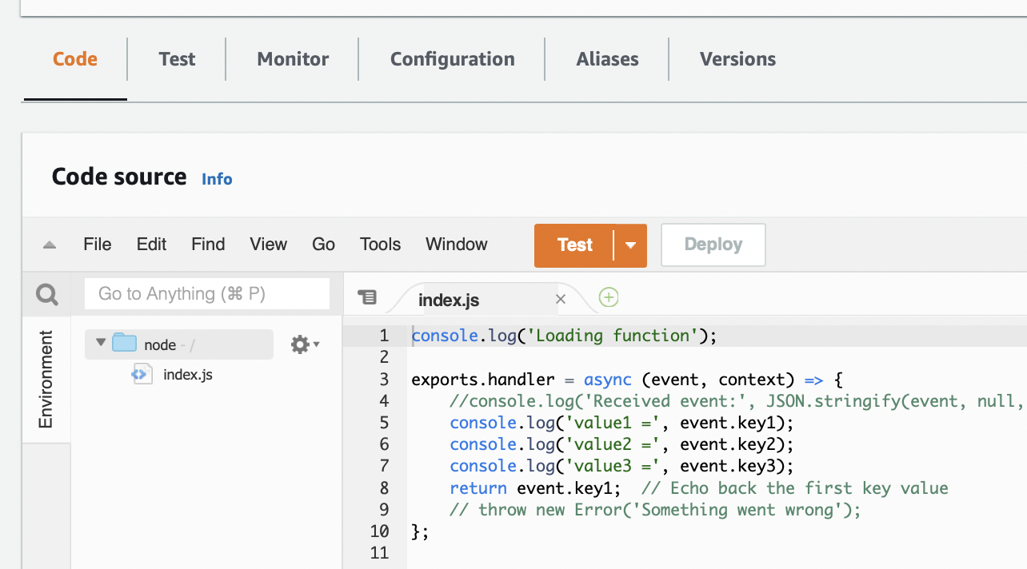

Slide 6
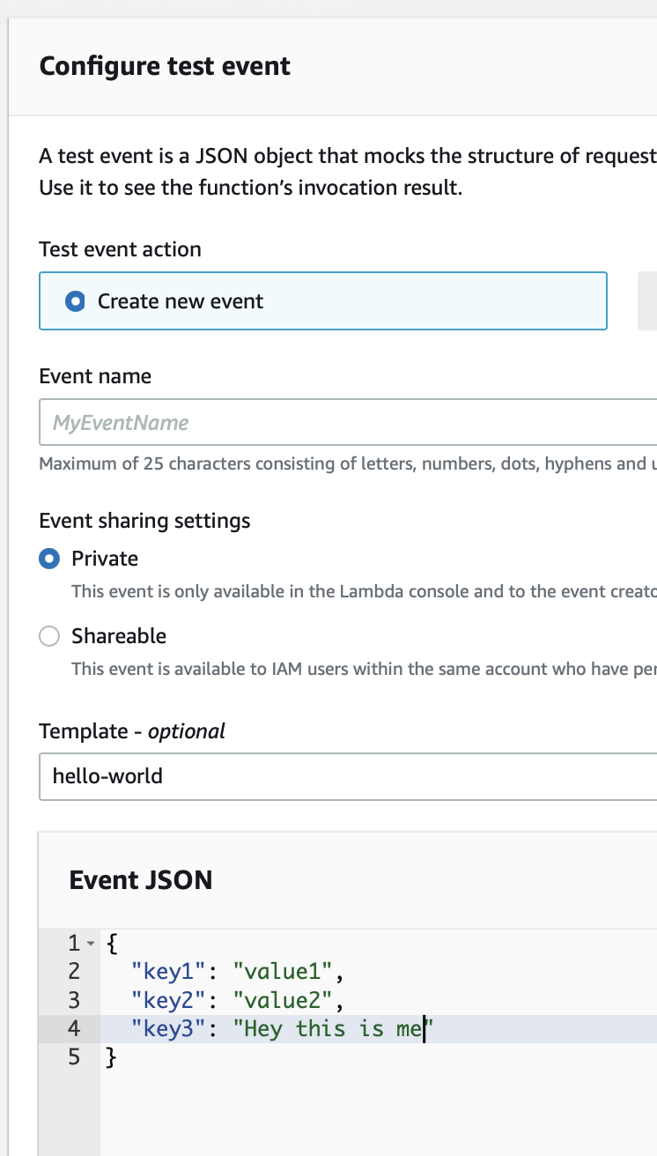
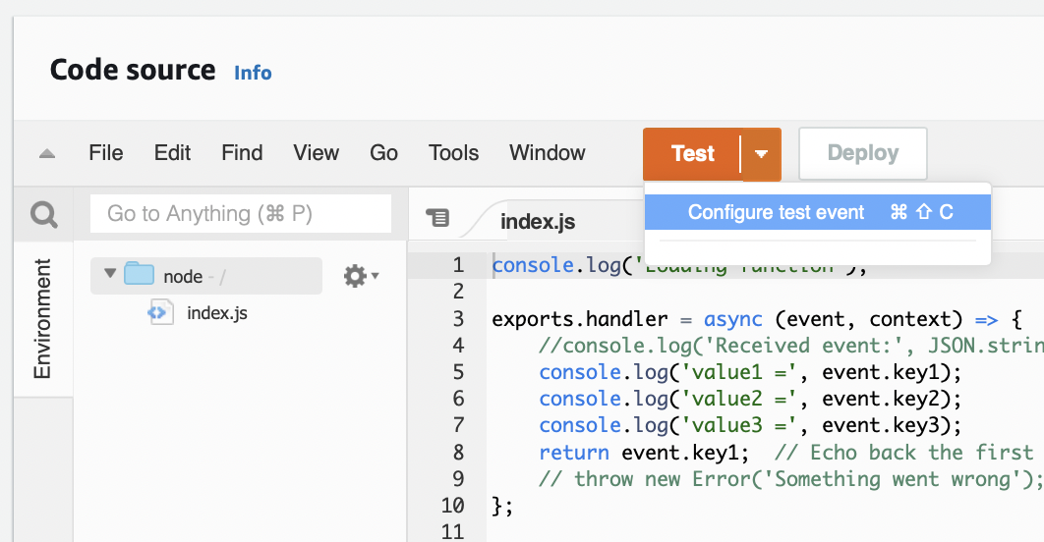
Creating a test scenario
Name your Test Event

Slide 7
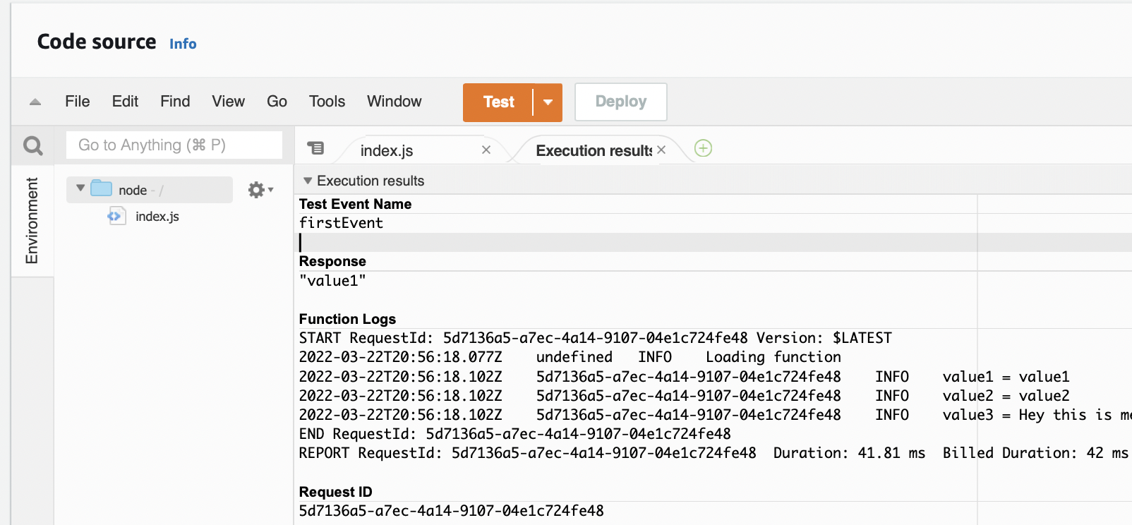

Slide 8
Next Tutorial – Quote Application Build a Basic Web Application

Slide 9
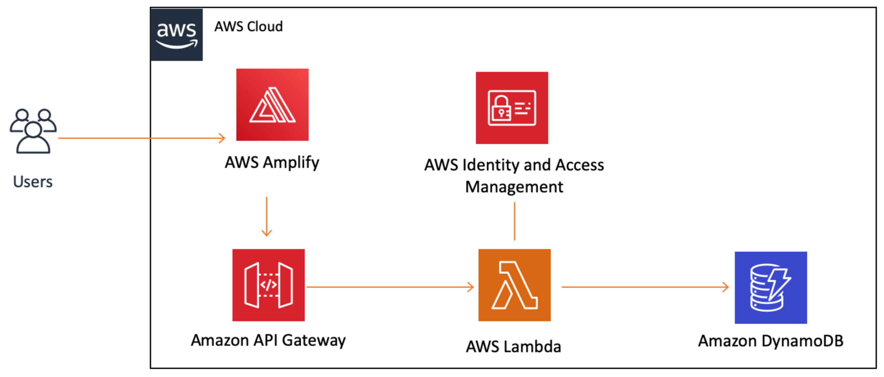
Build a Basic Web Application

Slide 10
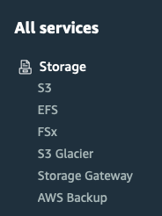
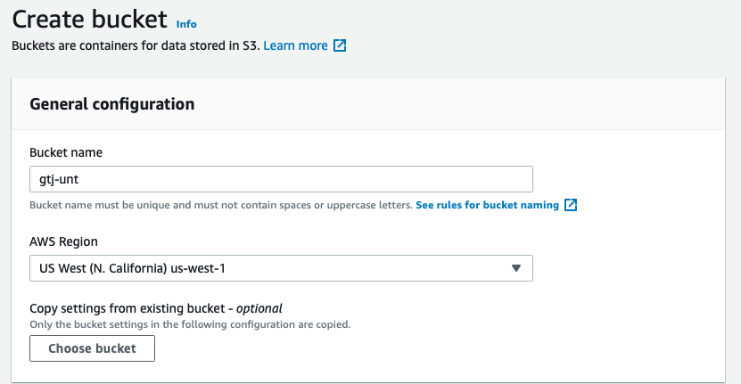
Creating your Bucket
Unique name
AWS Region

Slide 11
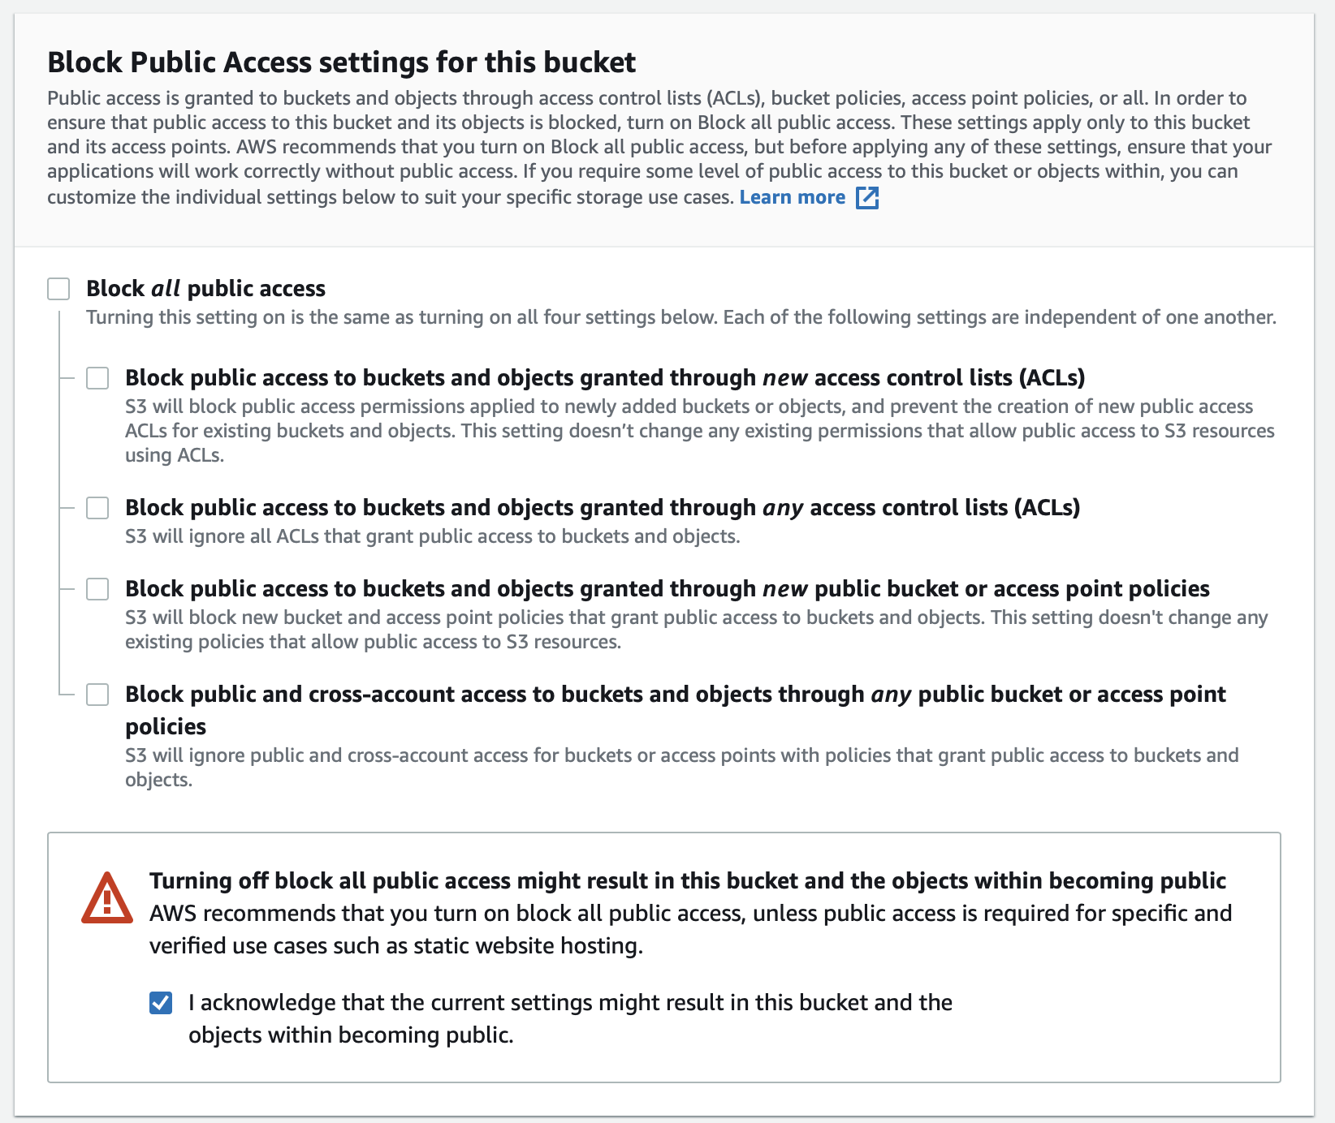
Public Access
Look below the General Configuration block
You can unBlock all Public Access here

Slide 12
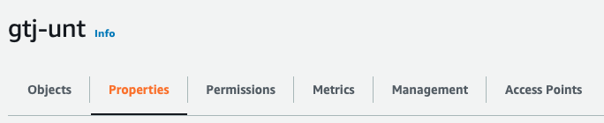
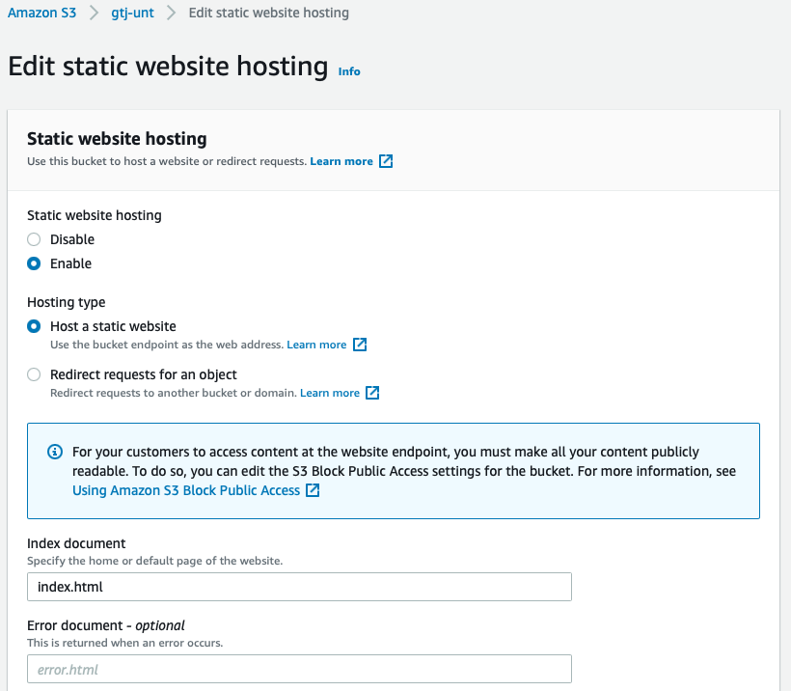
Properties
Static website hosting
Enable
Index document
Specify the default page

Slide 13
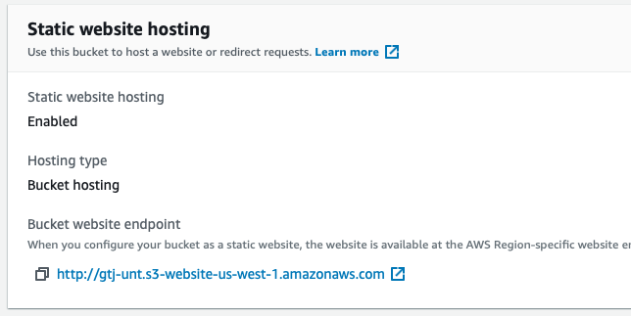
Properties
After saving your changes
Your Bucket website endpoint is now created

Slide 14
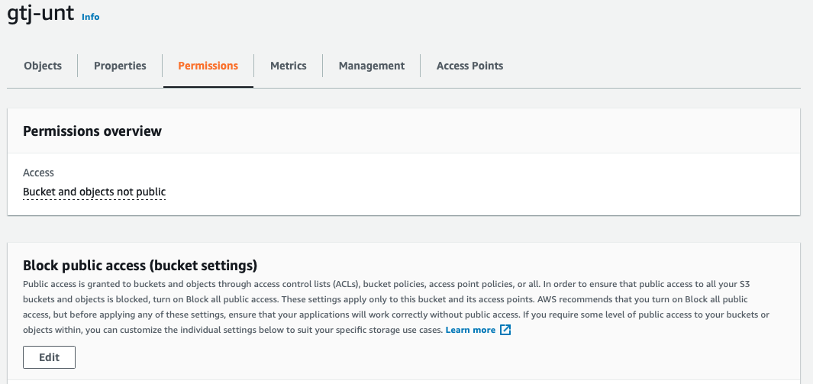
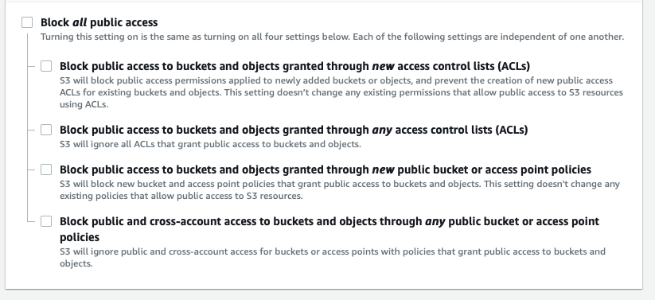
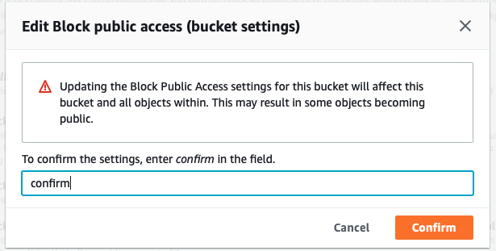
Permissions
Block public access
Uncheck
Block all public access
Because this is risky
Confirm your intention

Slide 15
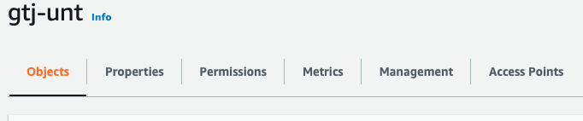
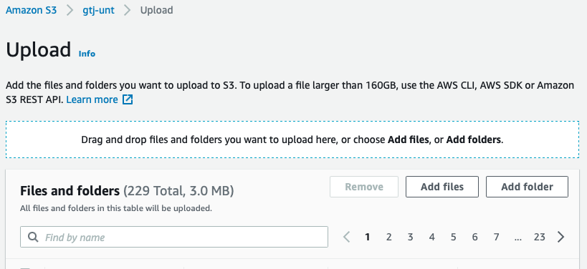
Upload Objects
Choose your local files to be used for your web site
Drag them to the upload screen

Slide 16
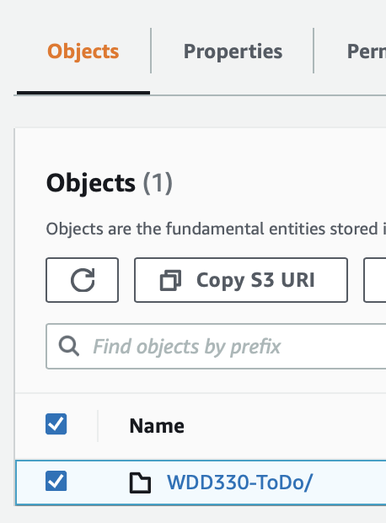
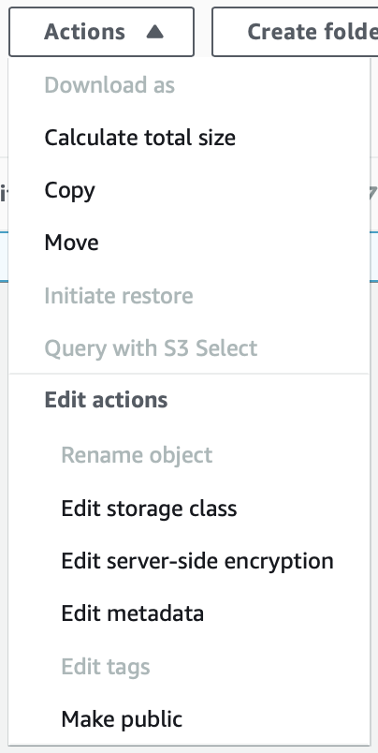
Make your Objects public
Select your just uploaded files
Actions drop down
Make public

Slide 17
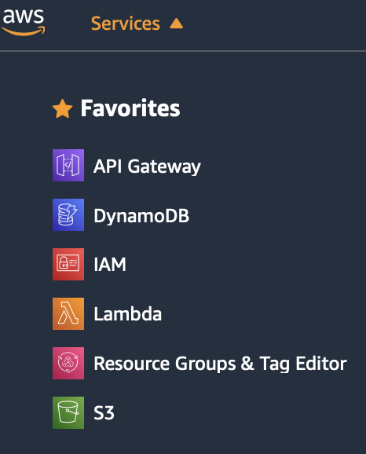
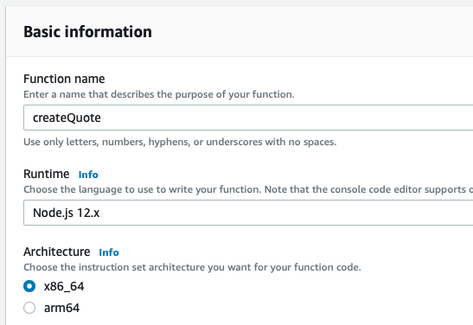
Lambda Functions
Create the function
Author from scratch
Create the name
Choose the Runtime

Slide 18
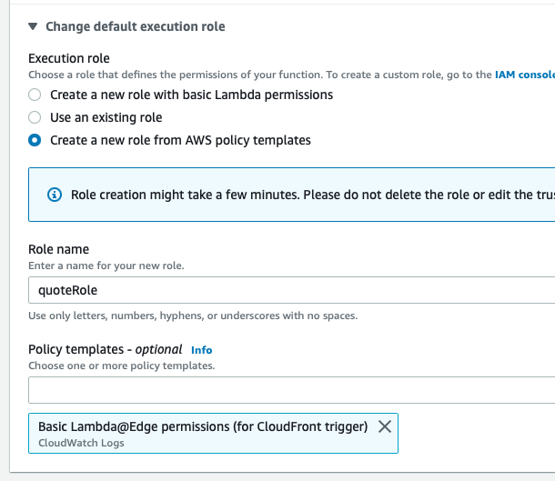
Lambda Functions
Create a new role from AWS policy templates
Role name
Search for and select the Basic Lambda@Edge permissions

Slide 19
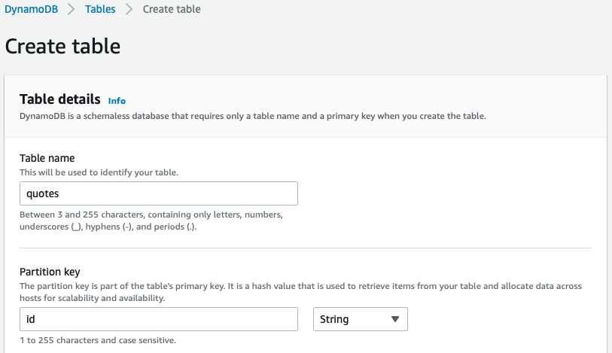
Create table
Table name
Partition key
Key type?

Slide 20
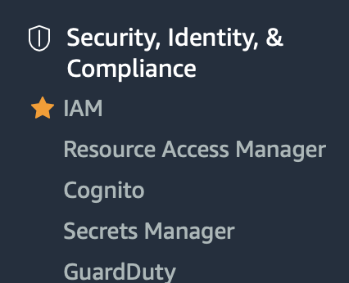
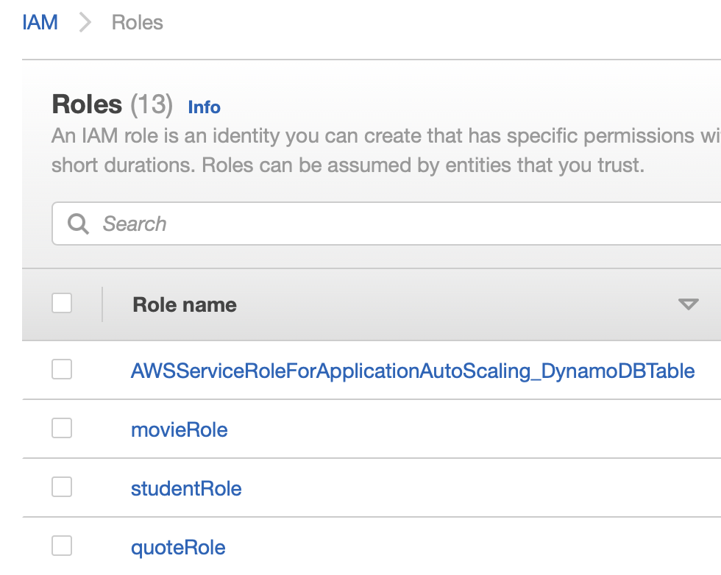
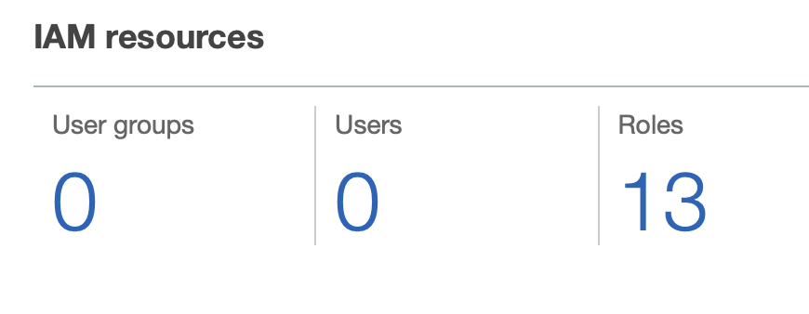
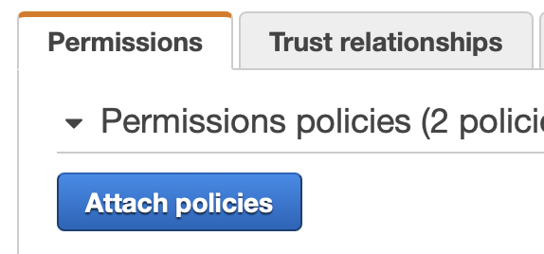
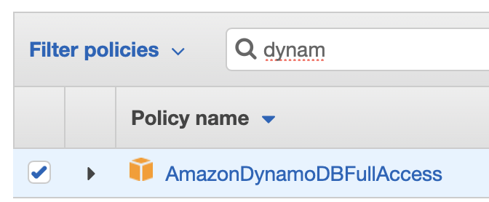
Identity and Access Management
Click on Roles
Find the role
Attach policies
Search for Dynamo
Select AmazonDynamoDBFullAccess
IAM – Assign roles to enable services

Slide 21
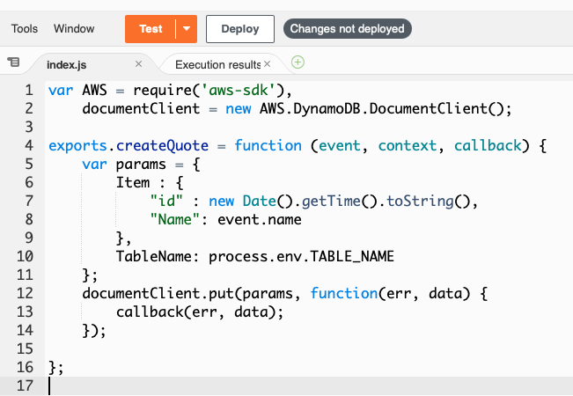
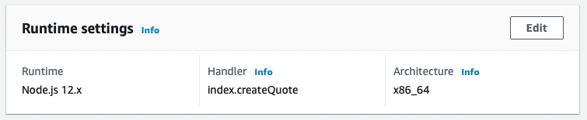
Back to our Lambda Function
Create the code for the function
Edit the Handler name in Runtime settings

Slide 22
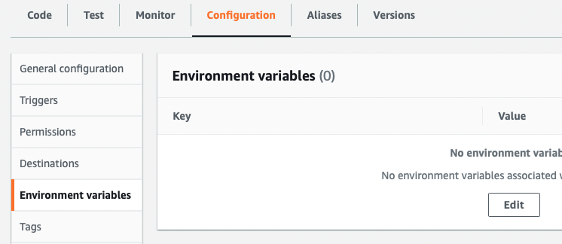
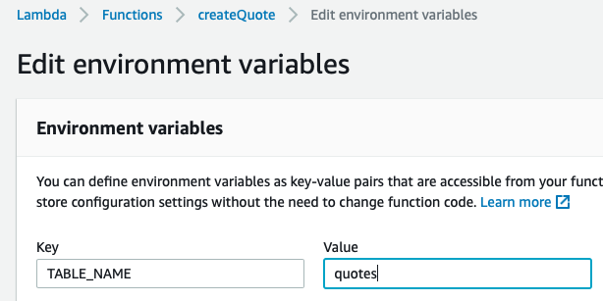
Environment variable
Create an Environment variable
Configuration panel
Environment variables tab

Slide 23
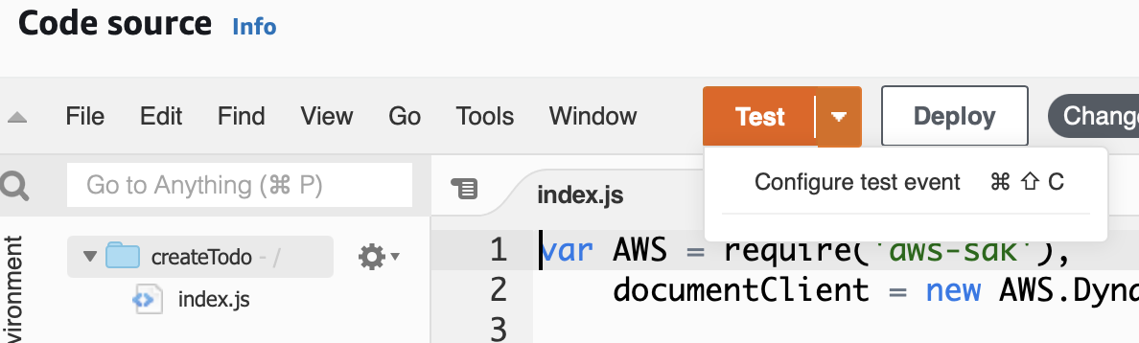
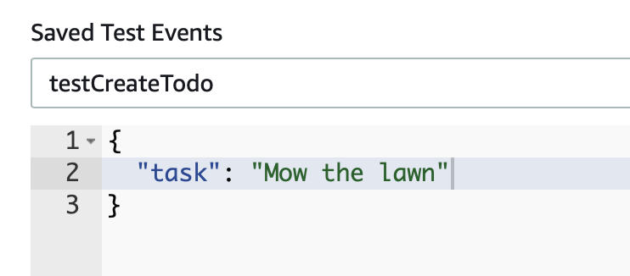
Create a Test
Configure test event
Create the JSON input attributes

Slide 24
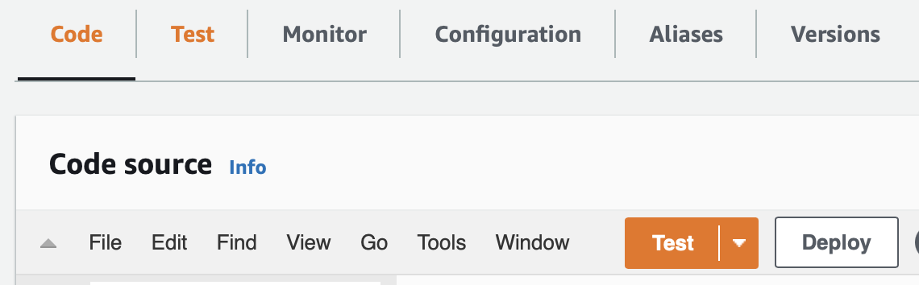
Deploy and Test the code
Click the Deploy button
Click the Test button
The magic happens
Go to DynamoDB page to see the insert happened

Slide 25
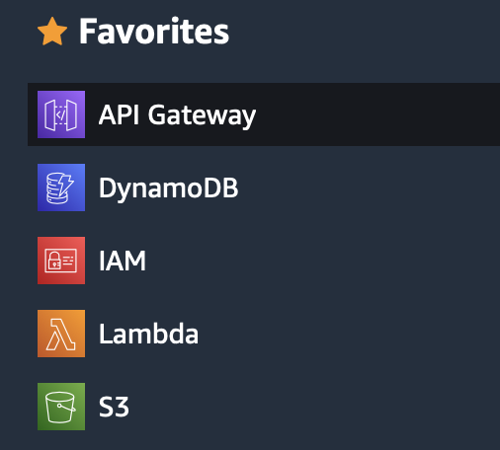
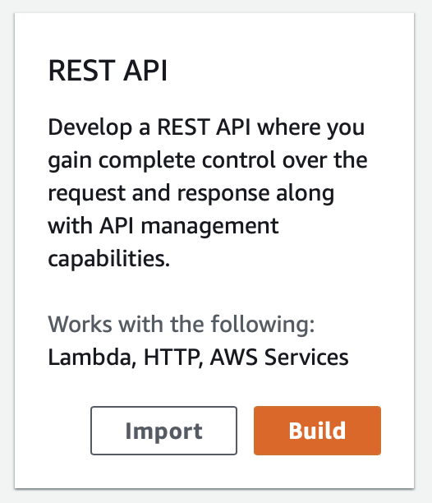
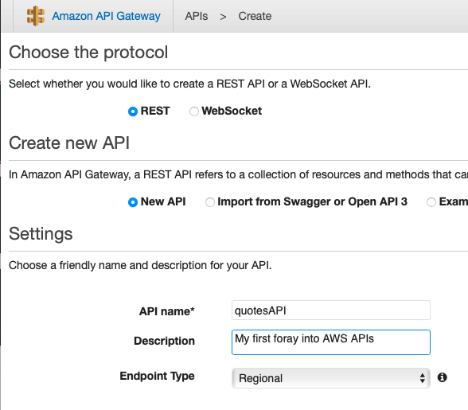
Create the API Gateway
Create a REST API
Give it a name to match your MVC

Slide 26
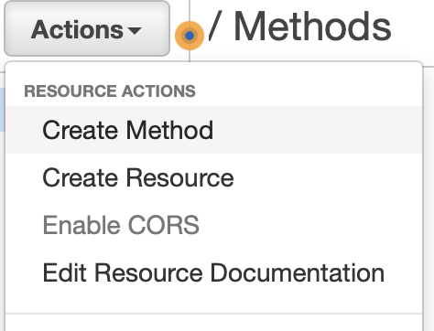
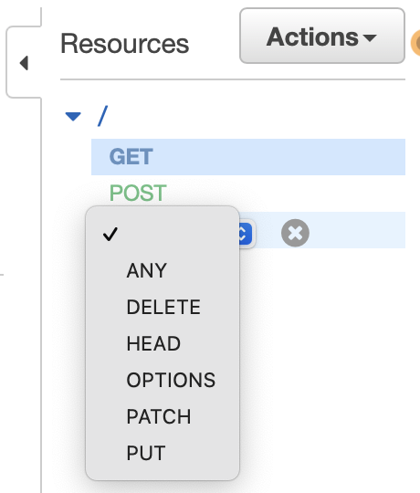
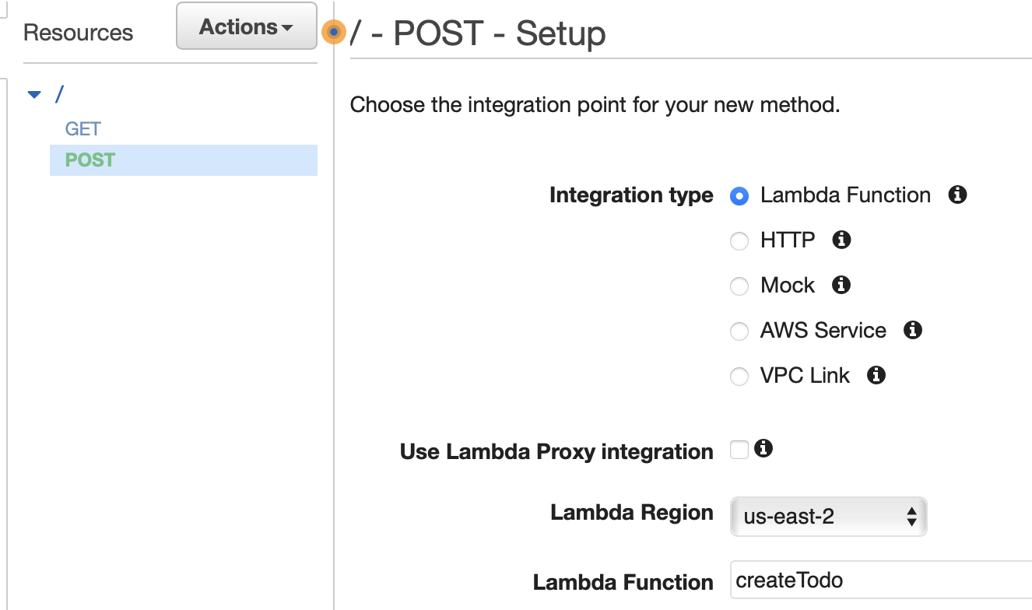
Add Methods to the Gateway
Create a Method
Choose the HTTP verb
Associate Action with the Lambda function

Slide 27
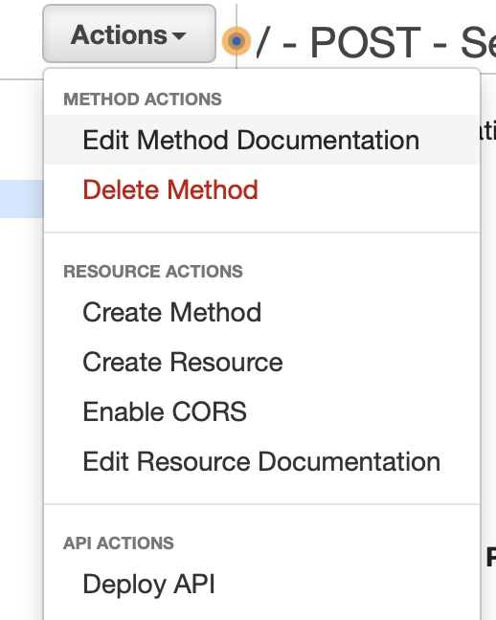
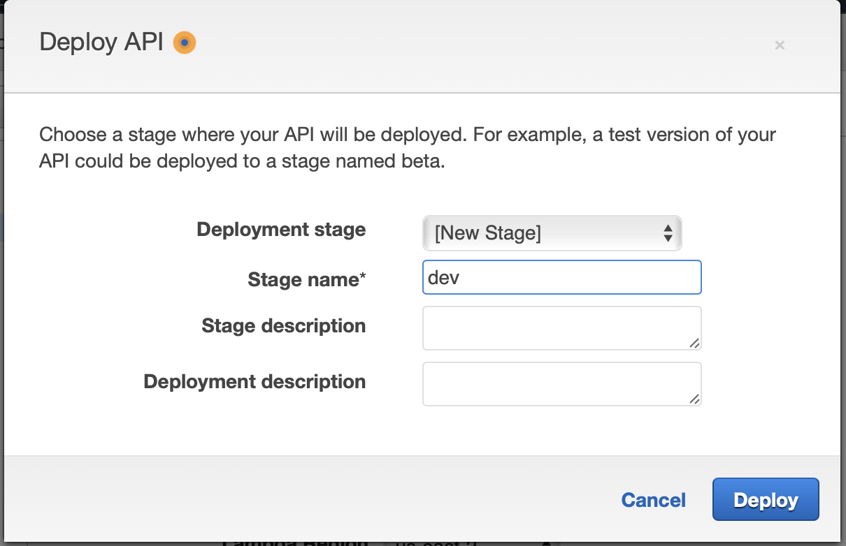
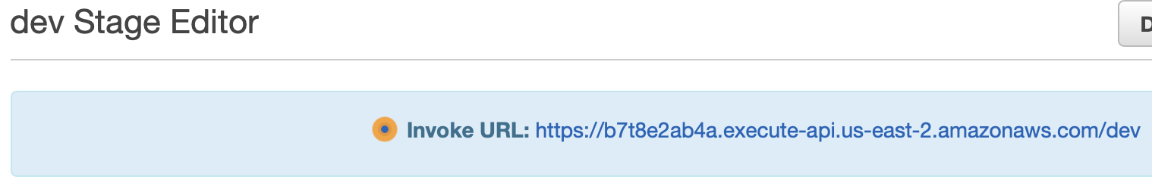
Deploy your API Gateway
Deploy API
Define the stage of the API
Now you have a URL for your requests

Slide 28
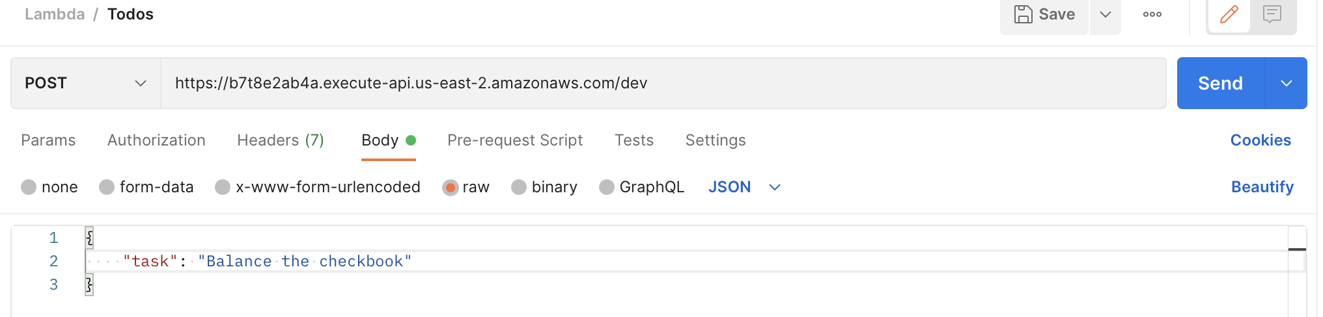
Postman
Use Postman to test anything beyond GET
POST, PUT, DELETE

Slide 29
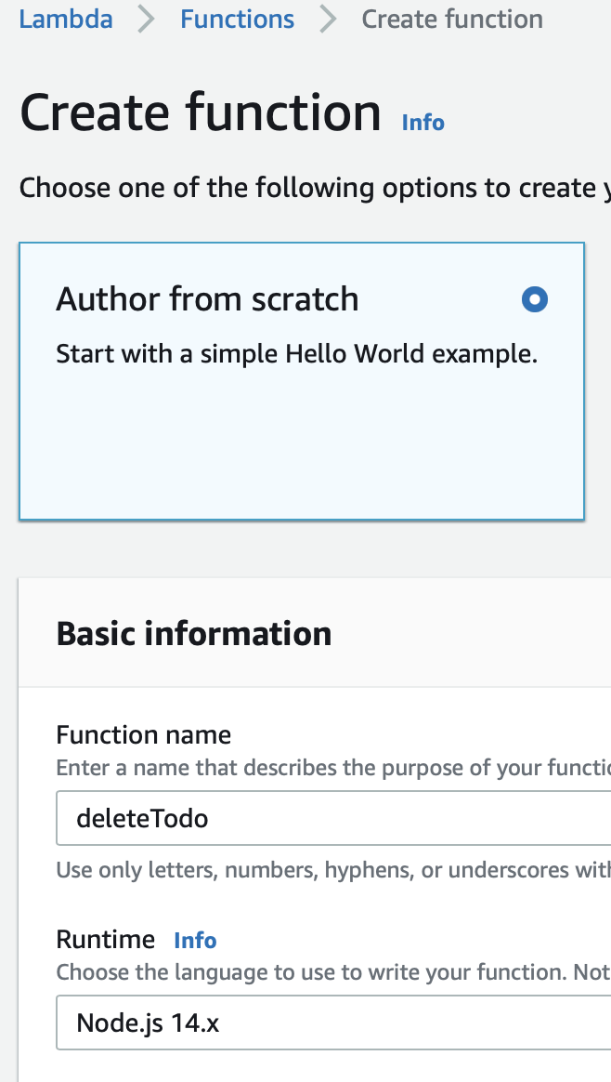


One more Lambda
Create a Delete function
Don’t forget the role
Minor change to the scan function is all we need

Slide 30



Back to the API Gateway
Add the DELETE method

